Slide 1
Object-oriented model with UML III (Introduction)
Zhang Jinyu – zjy@bjtu.edu.ch
School of Computer and Information Technology
SD 408

Slide 2
Architectural design - Revisit
1
System requirements
Iteration
系统需求
根据需求和架构风格确定关键子系统和配置
确定子系统的控制模型
将子系统分解为模块(例如，数据流、对象组件、服务、事件等)
2
Identify key sub-systems and configuration – informed by requirements & architectural styles
3
Identify model of control for sub-systems
Decompose sub-systems into modules (e.g. dataflows, objects, components, services, events etc.)
4

Slide 3
Modular decomposition
另一个结构层次，子系统被分解为模块。例子包括对象、数据流、组件、服务等
Another structural level where sub-systems are decomposed into modules.
– Examples include objects, dataflow, components, services etc.
Our modular decomposition approach will be object-oriented
In an object model the system is decomposed into interacting objects
Other modular decomposition approaches include dataflow, service-oriented, component-based etc.
组件可由一个或多个对象构成
业务是组件，组件不一定是业务
业务：共享，标准化，完整（不需要接口）
我们的模块化分解方法将是面向对象的
在对象模型中，系统被分解为相互作用的对象
其他模块化分解方法包括数据流、面向服务、基于组件等。

Slide 4
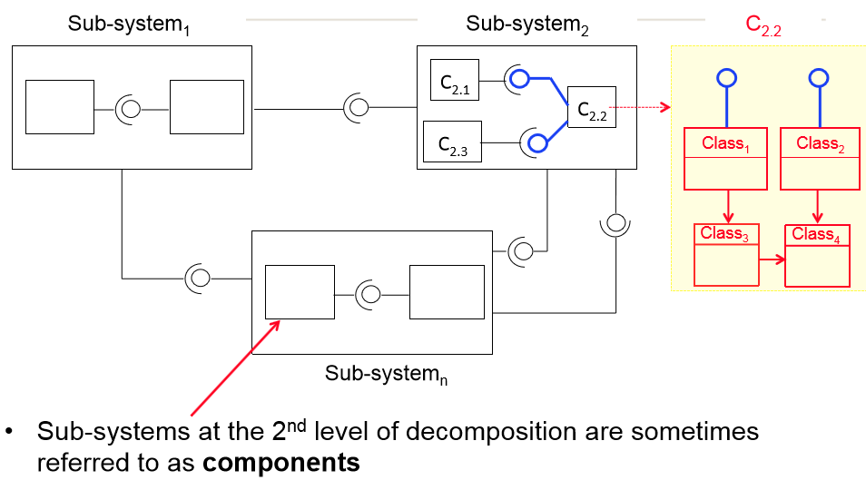
Sub-systems, & object classes
过滤器模型
C：组件
子系统在第二层被叫做组件

Slide 5

Learning outcomes
After studying today’s material, you should be able to:
Read and write basic class diagrams using UML (Unified Modeling Language)
UML is the standard notation for describing/modeling object-oriented software systems
References
Martin Fowler, “UML Distilled”
(Chapters 1, 3, 4, 5, 6, 10)
(统一建模语言)

Slide 6
Object-orientation
What are the key features of object-orientation?
Objects
Classes
Relationships
Interfaces
Polymorphism
实体
总体
类间相互作用
类与外界接口
多态，子类父类方法

Slide 7
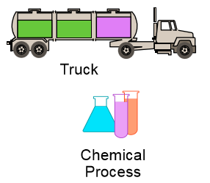
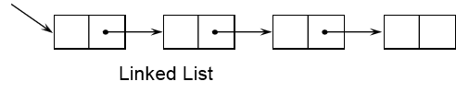
Objects
实体
Informally, an object represents an entity, be it physical, conceptual, or software
Something physical
A concept
Software

Slide 8
More formally
• An object has:
State
Represented by a set of attribute values + the links the object may have with other objects
E.g. Bank Account
Bank Name, Account No, Account Name, Balance, Transactions.
Changes over time
Behavior
Defined by what it does in response to receiving a request from another object
An object can only respond to requests that it understands, i.e. operations it has implemented
Identity
Each object has a unique identity, even if its state is identical to that of another object
核心，决定你是谁
状态：由一组属性值+对象可能与其他对象的链接表示。
随时间改变
行为：
定义为它在接收来自另一个对象的请求时所做的响应。
一个对象只能响应它理解的请求
影响状态
实体：
每个对象都有唯一的实体，即使它的状态与另一个对象的状态相同

Slide 9
Classes
A class is a description of a group of objects with common:
Attributes (properties or features)
Behavior (operations forming its interface)
Links
Semantics
A class is an abstraction in that it:
Emphasis relevant characteristics (i.e. its interface)
Suppresses other characteristics (i.e. its implementation)
属性
行为
关系（继承）
语义（作用范围）
一个类是一个抽象，
强调相关的特征(即它的接口)
抑制其他特征(即其实施)

Slide 10
Attributes and operations
An attribute is a property of a class
It describes a range of values that the property may hold in objects (i.e. instances) of that class
A class may have zero or more attributes
An operation is a function that can be performed by an instance of a class
属性是类的属性
它描述了属性在该类的对象中可能持有的值的范围
类可以有零个或多个属性
操作是可以由类的实例执行的函数

Slide 11
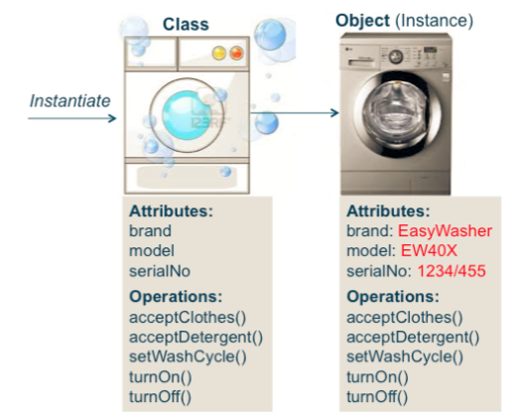
Classes and instances
An object is an instance of a class
To create a particular object of a class, the class must be instantiated
The terms object and instance are synonymous
一样的

Slide 12
Generalization - Inheritance
泛化 继承
Classes often have a certain amount in common with each other … which means
Classes can be arranged in a generalization hierarchy that shows the relationship between general and more specific classes
The more specific class is completely consistent with its parent class but includes additional properties
Object-orientation allows classes to inherit commonly used state and behavior from other classes
Subclasses inherit all the attributes and operations of their parent classes, but are also able to define additional attributes and operations
类可以安排在泛化层次结构中，以显示一般的以及更具体的类。
更具体的类与它的父类完全一致，但包含额外的属性
面向对象允许类从其他类继承常用的状态和行为

Slide 13
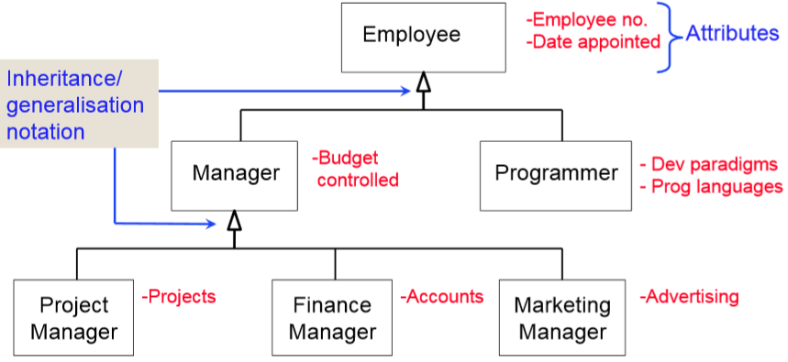
Inheritance/generalization example

Slide 14
Relationships
关联
类之间通常以某种方式相互关联
一个对象可以与多个对象相关联
多重性标识一个类中与关联类的单个对象相关的对象的数量
Association
Classes are typically related to one another in some fashion
For example when a student registers for a university degree course s/he is in association with the course
An object can associate with more than one object
Multiplicity identifies the number objects of one class that relate to a single object of the association class

Slide 15
汇聚、组成
Aggregation and Composition
Aggregation is a special form of association that connotes a “whole/part” relationship
Composition is a form of aggregation involves a strong relationship between an aggregate class (i.e. whole) and its component classes
In a composition the component class exists as component only within the composite class
聚合是一种特殊的关联形式，它意味着“整体/部分”关系
例如，桌子与桌面，没有亲缘关系
组合是聚合的一种形式，它涉及聚合类(即整体)与其组件类之间的紧密关系
在组合中，组件类仅作为组件存在于组合类中

Slide 16
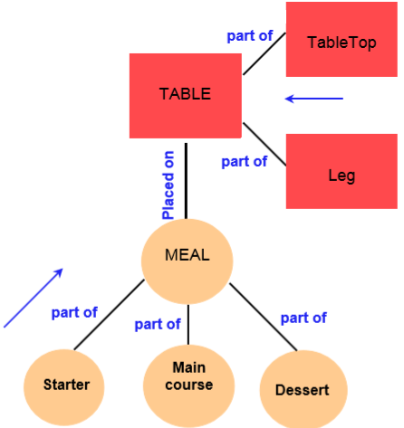
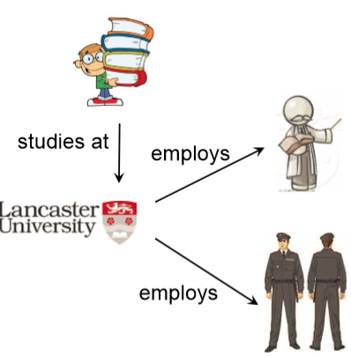
Association and Aggregation
强调整体与部分
注意箭头是否有方向

Slide 17
Interface
An interface is a set of operation signatures
A class may implement several interfaces
E.g. if you write a GUI class in Java you might implement both the MouseListener and KeyListener interfaces
An interface may be implemented by several classes
E.g. a Recyclable interface could be implemented by a class called Paper, a Glass class and a Battery class!
Unlike a class, an interface can’t have state or method implementations, and it can’t be instantiated
接口是操作签名的集合。
一个类可以实现多个接口
例如，如果你用Java编写一个GUI类，你可能同时实现MouseListener和KeyListener接口
一个接口可以由多个类实现，
例如，一个可回收的接口可以由一个叫做Paper的类、一个Glass类和一个Battery类实现!
与类不同，接口不能有状态或方法实现，也不能实例化
接口里没有成员变量，都是常量，即final static

Slide 18
Basic OO modelling with UML
The key features of object-orientation can be visualized using the UML (Unified Modeling Language)
More on the UML next week

Slide 19
UML Diagrams
UML has three main kinds of diagrams, Static, Dynamic and Physical
Static diagrams describe the logical structure of software elements by depicting, classes, objects, and data structures and the relationships between them
Dynamic diagrams show how software entities change during execution by depicting the flow of execution, or the way entities change state.
Physical diagrams show the unchanging physical structure of software entities by depicting physical entities such as source files, libraries, binary files, data files their relationships •
Today we look at one type of UML diagram, the class diagram, which allows us to view classes, interfaces and the relationships between them
静态图通过描述类、对象和数据结构以及它们之间的关系来描述软件元素的逻辑结构，use case,类图是静态图
动态图通过描述执行流程或实体改变状态的方式，展示了软件实体在执行过程中是如何变化的。序列图，状态图
物理图通过描述物理实体(如源文件、库、二进制文件、数据文件)及其关系来显示软件实体的不变物理结构。组件的物理位置

Slide 20
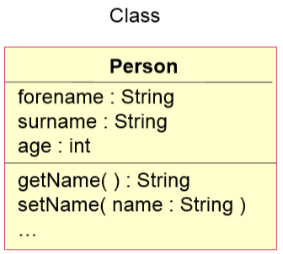
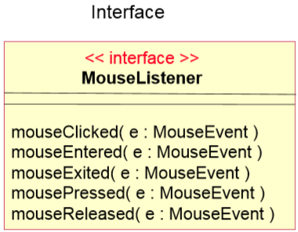
Classes and interfaces

Slide 21
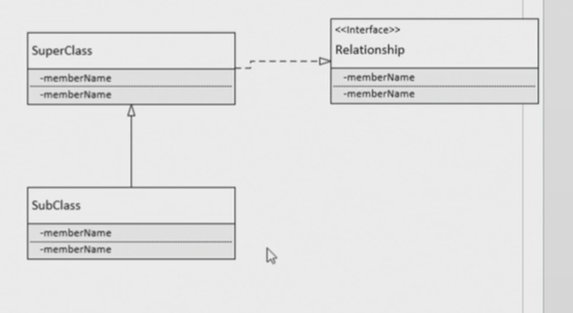
虚线，父类实现接口
实线，子类继承父类

Slide 22
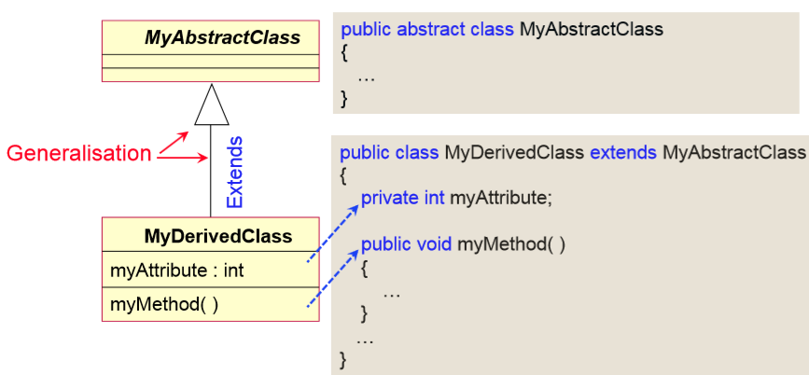
Generalization (inheritance)
继承

Slide 23
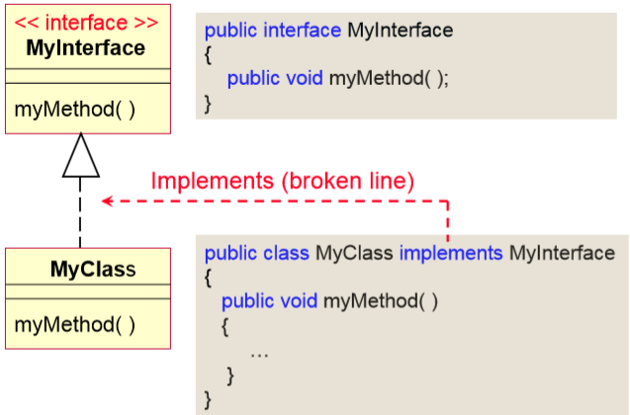
Implements (realization)
实现

Slide 24
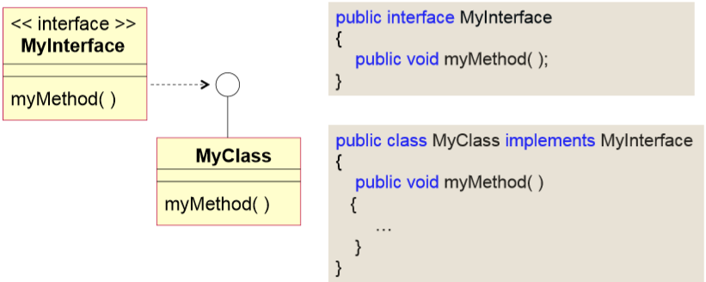
Implements (realizes)

Slide 25
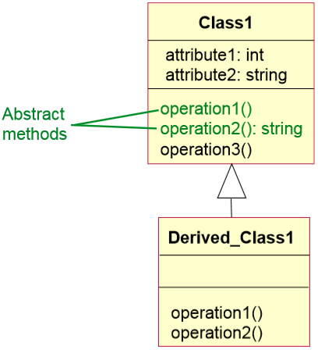
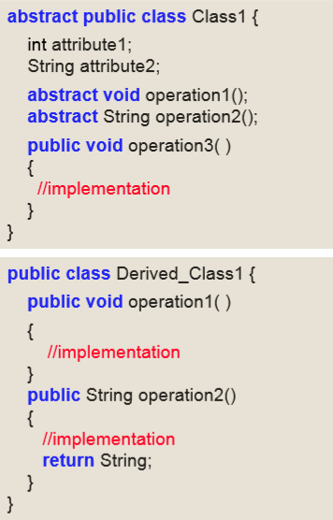
Abstract Class
子类必须实现父类抽象方法

Slide 26
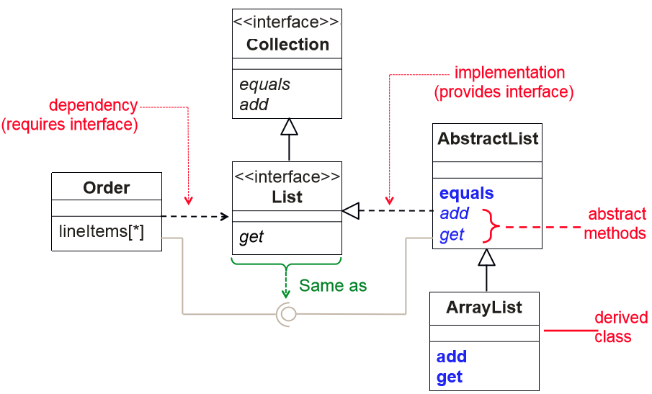
Example of interfaces & abstract class
类作为参数

Slide 27
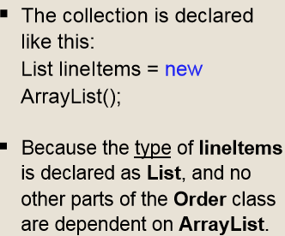
Example of interfaces & abstract class
类的裁剪：实现接口

Slide 28
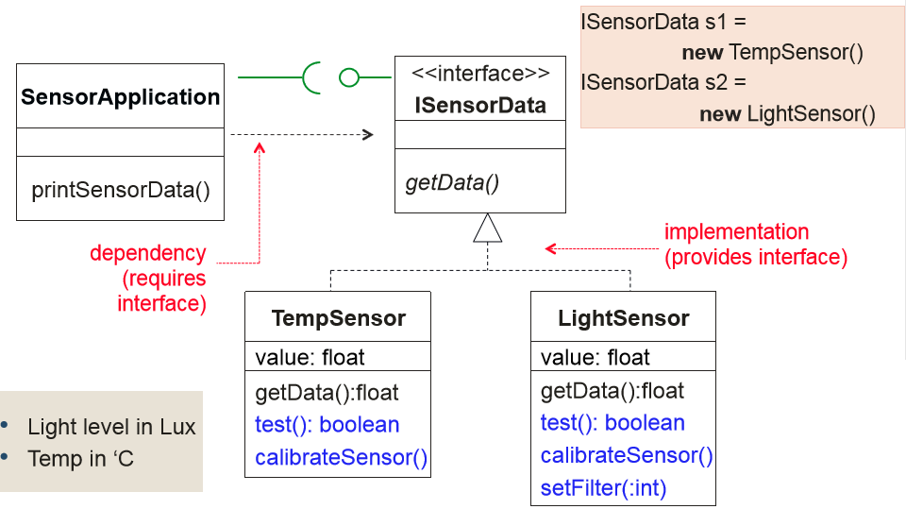
Sensor interface example
有成员变量 ISensor

Slide 29
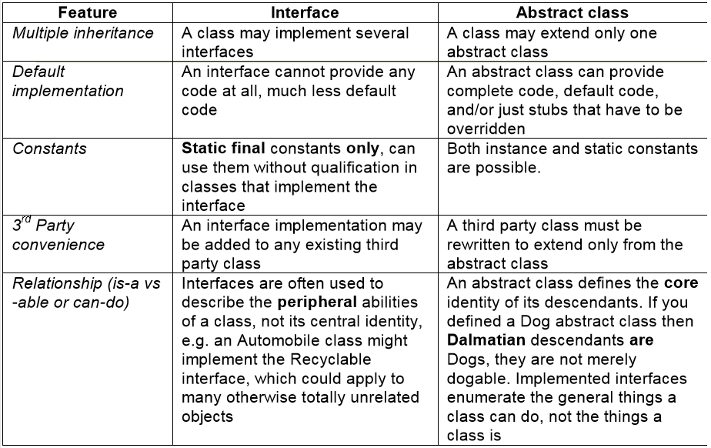
Interface vs. Abstract class
考试题
is-a因为所以
接口通常用来描述类的外围功能，而不是它的中心标识，
抽象类定义其后代的核心标识。

Slide 30
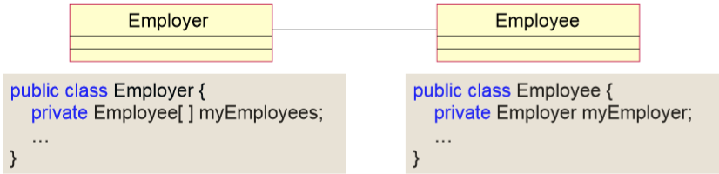
Association

Slide 31
An association is a key dynamic relationship between objects and can be represented on a class diagram.
An Employer object knows about Employee objects (it can store references to multiple Employee objects in its array). Similarly, an Employee object stores a single reference to its Employer object.
The relationship is thus bidirectional – an Employer object can invoke the methods of the Employee objects it knows about, and an Employee instance can invoke methods on its Employer object.
关联是对象之间的关键动态关系，可以在类图中表示。

Slide 32
Association
Associations are, by default, bidirectional •
However, it is not always necessary or even desirable to have a bidirectional relationship
Bidirectional relationships introduce mutual dependencies • Employer is dependent on Employee and vice versa
Unidirectional relationships are simpler and reduce dependencies among classes
LinkedList knows nothing of AddressBook, but AddressBook knows about LinkedList
默认情况下，关联是双向的．然而，双向关系并不总是必要的，甚至也不总是可取的。双向关系引入了相互依赖。单向关系更简单，减少了类之间的依赖性

Slide 33
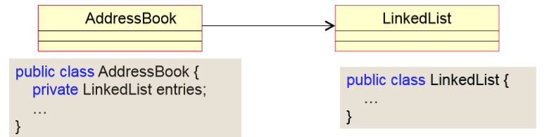
不知道谁用我

Slide 34
Association multiplicity
Multiplicity is a constraint on the number of instances of one class that can be related to one instance of the other class
For each association, there are two multiplicity decisions to make – one for each end of the association
E.g.
For each instance of Person, how many Vehicle objects can be registered with it?
For each Vehicle object, how many registered keepers (Person instances) can it have?
多重性是对一个类可以与一个类相关的实例数量的限制
对于每个关联，都有两个多重性决策要做——关联的两端各一个

Slide 35
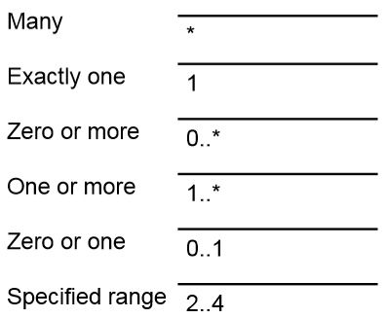
Multiplicity constraints
Each end of an association contains a multiplicity indicator which represents the number of objects that participate in the relationship
Many

Slide 36
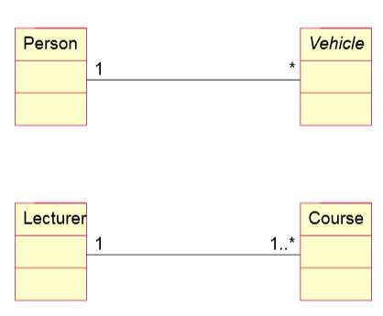
Interpreting multiplicity
Can a Vehicle have more than one registered keeper?
Must a Vehicle have a registered keeper?
Can a lecturer be on sabbatical?
Would a lecturer be happy with this model?

Slide 37
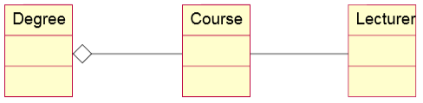
Aggregation
Aggregation is a special form of association in which one class plays the whole and the other its part
Aggregation is also known as part-of, or containment
An aggregation is represented as an association with a diamond next to the class denoting the whole
聚合也称为部分或包含
聚合表示为一个关联，在表示整体的类旁边有一个菱形

Slide 38
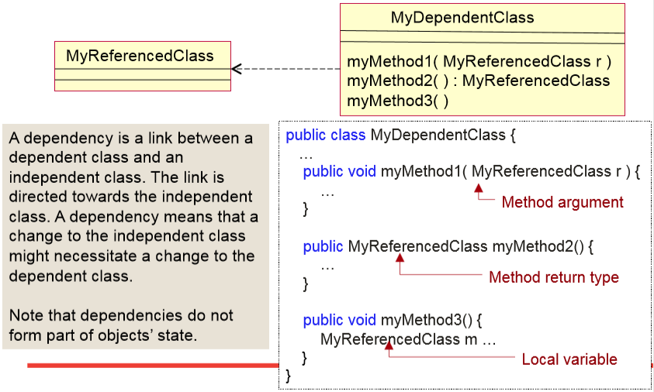
Dependency
一个类是另一个类方法的参数
依赖项是依赖类和独立类之间的链接。链接指向独立类。依赖关系意味着对独立类的更改可能需要对依赖类的更改。注意，依赖关系不构成对象状态的一部分。

Slide 39
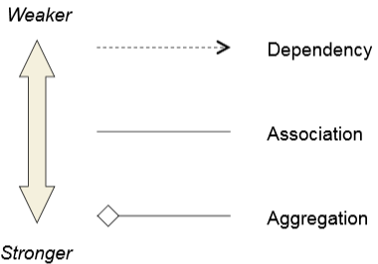
A final word on relationships
All these relationships represent some sort of dependency between classes.
A UML dependency link is a dependency between classes that, unlike association and aggregation, is not implemented using instance variables.
An association links classes whose instances have independent lifetimes (an instance of one class can exist without the other).
An aggregation links one class (the whole) to its part class. An instance of the part class should not exist without being connected to its whole object.
相互独立
part类不应该单独存在，需要连接整体

Slide 40
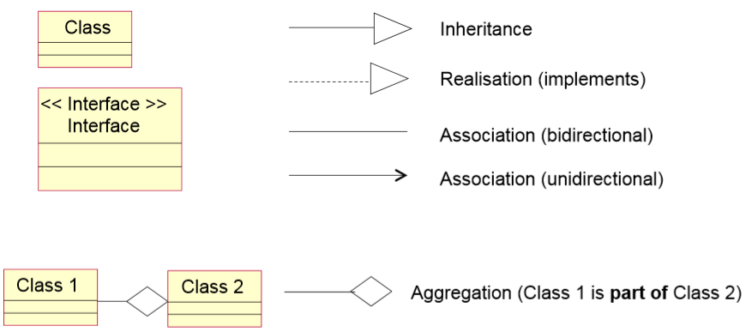
Summary of Basic UML notation

Slide 41
Technique for identifying object classes + relationships
Grammatical approach
Object classes and attributes are nouns. Examples include tangible entities (things) in the application domain
such as aircrafts, vehicles, servers, resources
roles such as managers, customers, operators
interactions such as meetings • locations such as offices, organizational units such as companies and so on
Operations are verbs.
E.g. actions carried out by an object class

Slide 42
Relationships (questions to ask when analyzing object classes)
Is the object class a subclass of another? Is so the relationship is generalization (i.e. inheritance)
Is the object classes part of another? If so, the relationship is aggregation.
Does the object class interact with another? If so, indicate the relationship by drawing an arrowed line in the direction of the relationship. •
Name the interaction and Show the multiplicity (number of objects of one class that relate to a single object of the other class?)

Slide 43
Question？

